Slide 1

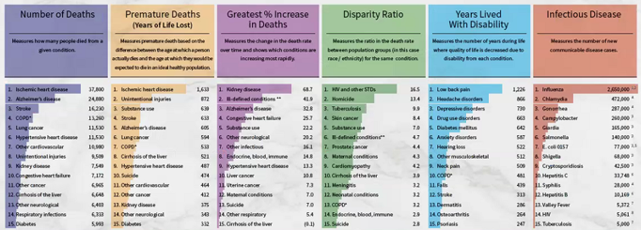
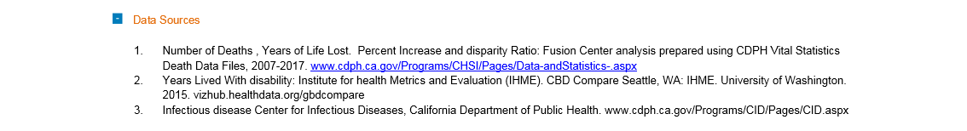




should be based, where feasible, on objective assessments of health status, burden of disease, injury, and disability, their preventability, and related costs. Our approach can’t be it must be “yes/and”
expanding the repertoire of measures of the public’s health is a critical step in targeting attention and resources to improve health
1
Exploring Disparities
Measuring Public Health
Public Health Measures
2
There are many ways to view the health status of Californians, but the limited allocation of resources can create “either/or” situations. Expanding our tools and measures in public health helps create “yes/and” innovative solutions which target resources to improve health.
Public health looks across multiple measures to identify significant trends and public health challenges.
Number of deaths
This measure presents a ways of ranking conditions that cause death.
Number of deaths describes the absolute magnitude of the disease or condition and is a clear and easily understood measure. This measure does not take into account the “age distribution” or size of the population, so can be misleading if making comparisons. All measures using vital statistics death data are limited based on the accuracy of the coding of cause of death on the death certificate.
Premature Deaths: Years of Life Lost (YLL)
Percent Increase
Disparity Ratio
Years Lived with Disability
Infectious Disease
3
County Filter
Embedded object
Download Geographic Snapshot
4
Footnotes
COPD refers to chronic obstructive pulmonary disease.
Ill-defined conditions refer to symptoms and signs not elsewhere classified. More research is needed to determine whether the large number of deaths in this category relate to data coding issues and/or issues of health care access.
Social determinants of health are social, economic, and environmental factors that create or limit opportunity for health and powerfully influence health outcomes for entire populations
Average of low and high estimates for 2015-2016 season based on national estimates for influenza.
Condition not reportable to Public Health.
2011 CDC national foodborne burden of illness estimate.
2008 national estimates adjusted by CA proportion of population and increasing reports from 2008-2016.
STEC O157 underreporting and underdiagnoses multipliers used for reports of shiga-toxin positive stools and hemolytic-uremic syndrome.
Number of cases of chronic infection newly reported in 2015.
Number of cases reported in 2016.
New HIV infections diagnosed and reported in 2016.
5
?
CDPH Actions/Stories - CCB highlight
Information about
the CCB
This is a link to the CCB
6
7
Overall observations for the state 2019
Opportunities, data gaps or missing data highlights 2019
Written data summary of state display
Share Your Story
Want to engage in moving the dial on reducing disparities?
Share your impact story!

